Slide 1
Introduction to SDN
Portions of this PPT draw from PPT authored by Professor Dijiang Huang at
Arizona State University

Slide 2
Outline
Concept of SDN
OpenFlow – a SDN Implementation

Slide 3
What is SDN?
Software-Defined Networking, a.k.a. the programmable network
A new network architecture
A new network operating system
A Generalized network virtualization
(more…)

Slide 4
Why do we need SDN?
Do you think a Network system simple?
Networks used to be simple: Ethernet, IP, TCP….
New control requirements led to great complexity
Isolation ➔ VLANs, ACLs
Traffic engineering ➔ MPLS, ECMP,Weights
Packet processing ➔ Firewalls, NATs, middleboxes
Payload analysis ➔ Deep packet inspection (DPI)
…..
Mechanisms designed and deployed independently
Complicated “control plane” design, primitive functionality
Notes:
ECMP: Eqaul Cost Multi-Path routing strategy.

Slide 5
Networking Devices
Routing
Access Control
Traffic Engineering
Management
Protocol and operation model
Network Router
App
App
Interface Virtualization
Control and Management APIs
Operating System
Packet Processing
Forwarding
Switching

Slide 6
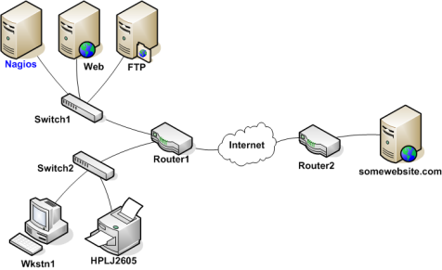
A Typical Network

Slide 7
Today’s Distributed Networking Systems
Close Boxes, Fully Distributed Protocols
App
App
App
App
Routing
Access Control
Traffic Engineering
Management
Operating System
Operating System
App
App
Packet Processing
Packet Processing
Operating System
Interface Virtualization
Control and Management APIs
Packet Processing
App
App
App
App
Operating System
Forwarding
Switching
Operating System
Packet Processing
Packet Processing
Traffic control decisions are mostly made locally, i.e., usually require a negotiation procedures among network entities (e.g., routing).
Not easy for testing and experiments, i.e., usually requires a separate testing environments.
Closed Operating Environment

Slide 8
Data processing and Control in Distributed Systems
Data processing and controls are not separated. Algorithms, e.g., routing, is performed in a distributed environment. Each router acts individually, much likes our current social networks.
App
App
App
App
Operating System
Operating System
App
App
Packet Processing
Packet Processing
Operating System
Packet Processing
App
App
App
App
Operating System
Packets
Operating System
Packet Processing
Packet Processing

Slide 9
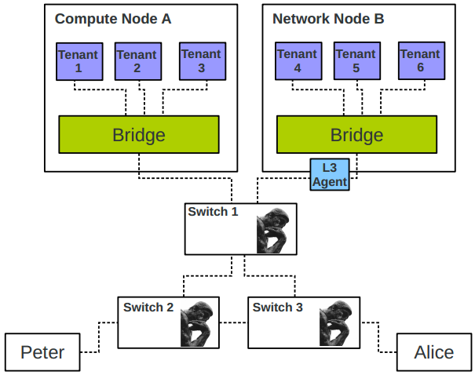
Switched Networks in OpenStack
Switches learn from the network traffic they observe and decide independently.

Slide 10
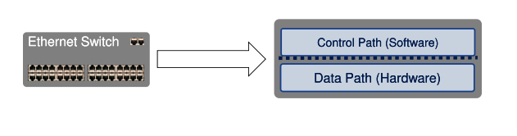
Traditional network node: Switch
Two “planes”
Control Plane: computing the forwarding state
Involves coordination with rest of system
Data Plane: forwarding packets
Based on local forwarding state

Slide 11
Two “planes”
Two fundamental terms to begin understanding the SDN
Processing Plane | Where it runs | How fast these processes run | Type of processes performed
Control Plane | Switch CPU (smart but slow) | In the order of thousands of packets per second | Routing protocols (i.e. OSPF, IS-IS, BGP), Spanning Tree, SYSLOG, AAA (Authentication Authorization Accounting), NDE (Netflow Data Export), CLI (Command Line interface), SNMP
Data Plane | Dedicated Hardware ASIC (fast but dumb) | Millions or Billions of packets per second | Layer 2 switching, Layer 3 (IPv4 | IPv6) switching, MPLS forwarding, VRF Forwarding, QOS (Quality of Service) Marking, Classification, Policing, Netflow flow collection, Security Access Control Lists
Notes:
ASIC: application-specific integrated circuit.
MPLS: Multiprotocol Label Switching
VRF: Virtual Routing and Forwarding

Slide 12
Traditional network node: Router
Router can be partitioned into control and data plane
Management plane/ configuration
Control plane / Decision: OSPF (Open Shortest Path First)
Data plane / Forwarding
Adjacent Router
Router
Adjacent Router
Management/Policy plane
Configuration / CLI / GUI
Routing
Control plane
Control plane
Static routes
Control plane
OSPF
OSPF
OSPF
Neighbor table
Link state database
IP routing table
Switching
Data plane
Data plane
Data plane
Forwarding table

Slide 13
SDN definitions
SDN is an approach to building computer networks that separates and abstracts elements of these systems – from Wikipedia
In SDN, not all processing happens inside the same device.
In the Software Defined Networking architecture, the control and data planes are decoupled, network intelligence and state are logically centralized, and the underlying network infrastructure is abstracted from the applications. – from ONF White Paper

Slide 14
How to do it?
How to get a simpler, more systematic design for the so complicate network control mechanisms?
The power of Abstraction
“Modularity based on abstraction is the way things get done.” – Barbara Liskov
Abstractions ➔ Interfaces ➔ Modularity

Slide 15
Finding control plane abstractions
Task: Compute forwarding state:
Consistent with low-level hardware/software
which might depend on particular vendor
Based on entire network topology
because many control decisions depend on topology
For all routers/switches in network
every router/switch needs forwarding state

Slide 16
SDN Abstractions
SDN is defined precisely by three abstractions: Forwarding, Distribution, Configuration
Abs#1: Be compatible with low-level hardware/software
Need an abstraction for general forwarding model
Abs#2: Make decisions based on entire network
Need an abstraction for distributed network state
Abs#3: Compute the configuration of each physical device
Need an abstraction that simplifies configuration
Notes:
Why “distributed state”? Because the communication in control programs is ALL directed towards collecting/disseminating/or calculating on distributed state.
Tell you how later, but this is the purpose of the abstractions…

Slide 17
Abstraction Detail
Abs#1: Forwarding abstraction
OpenFlow is current proposal for forwarding standard
Configuration in terms of flow entries: <header, action>
Abs#2: Network state abstraction
Global network view abstraction
Network OS (controllers) queries network devices to form “view” and sends commands to them to control forwarding
Abs#3: Specification abstraction
Abstract view of network: simple model with only enough to specify goals.
Network virtualization: map abstract configuration to physical configuration

Slide 18
From traditional networking to SDN
App
App
App
App
Global view
Programmability
Virtualization
Network Operating System
App
App
App
App
Operating System
Operating System
Networking Resource Isolation
Fine-grained access control
App
App
Packet Processing
Packet Processing
Operating System
Packet Processing
App
App
App
App
Operating System
Operating System
Packet Processing
Packet Processing

Slide 19
Abstract SDN Model
App
App
App
App
Network Virtualization
Network Operating System
Open interface to hardware
Simple Packet Processing: forwarding
Simple Packet Processing: forwarding
Simple Packet Processing: forwarding
Simple Packet Processing: forwarding
Simple Packet Processing: forwarding

Slide 20
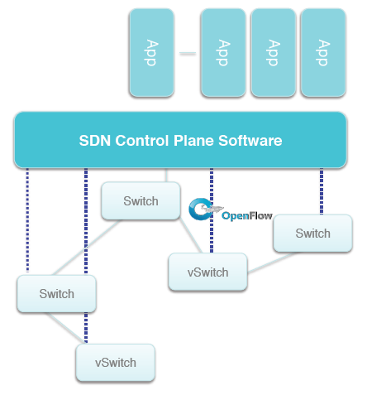
What SDN looks like
Application Tier
Control Plane Tier
(Network OS)
Data Plane Tier

Slide 21
Clean Separation of Concerns
Control program: express goals on abstract view
Driven by Operator Requirements
Virtualization Layer: abstract view ⬅➔ global view
Driven by Specification Abstraction for particular task
NOS: global view ⬅➔ physical switches
API: driven by Network State Abstraction
Switch interface: driven by Forwarding Abstraction

Slide 22
Software-Defined Networking
Data Plane Tier
Packet forwarding (as per flow table), packet manipulation (as per flow table), statistics collection
Control Plane Tier (Network OS)
Data plane resource marshaling, common libraries (e.g., topology, host metadata, state abstractions)
Application Tier
Virtual network overlays, network slicing (delegation), tenant-aware broadcast, application-aware path computation, integration with other software packages, policy, security, traffic engineering.

Slide 23
How to process the SDN requests?
Write a simple program to configure a simple model
Configuration merely a way to specify what you want
Examples
ACLs: who can talk to who
Isolation: who can hear my broadcasts
Routing: only specify routing to the degree you care
Some flows over satellite, others over landline
TE: specify in terms of quality of service, not routes
Virtualization layer “compiles” these requirements
Produces suitable configuration of actual network devices
NOS then transmits these settings to physical boxes
Abstract Network Model
Network Virtualization
Control Program
Global Network View
Network OS

Slide 24
Outline
Concept of SDN
OpenFlow – a SDN Implementation

Slide 25
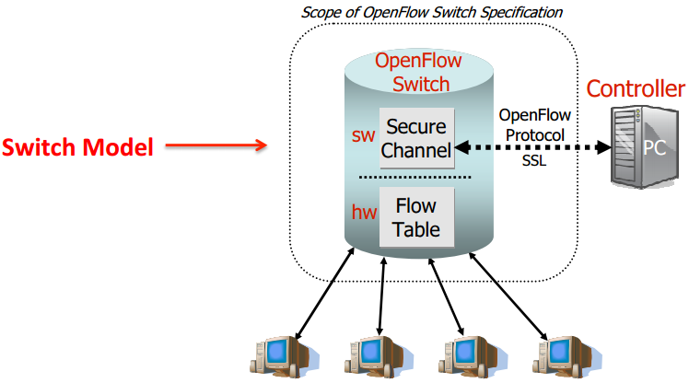

OpenFlow
OpenFlow is a Layer 2 communications protocol that gives access to the forwarding plane of a network switch or router over the network.
OpenFlow enables controllers to determine the path of network packets through the network of switches.

Slide 26
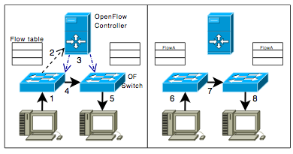
How it works?
The OpenFlow protocol is layered on top of the Transmission Control Protocol (TCP), and prescribes the use of Transport Layer Security (TLS).
Controllers should listen on TCP port 6653 for switches that want to set up a connection. Earlier versions of the OpenFlow protocol unofficially used port 6633.
Initial packet of a flow
The subsequent packets of the flow
A
B
A
B

Slide 27
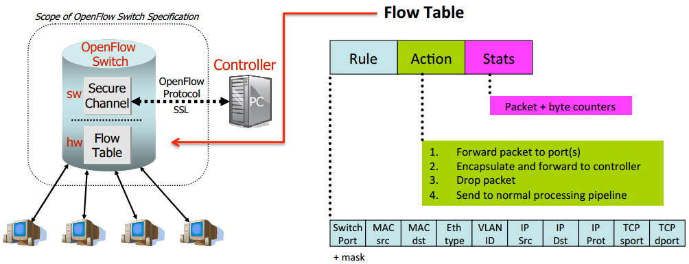
OpenFlow Switch, v 1.0
OpenFlow allows remote administration of a layer 3 switch's packet forwarding tables, by adding, modifying and removing packet matching rules and actions.

Slide 28
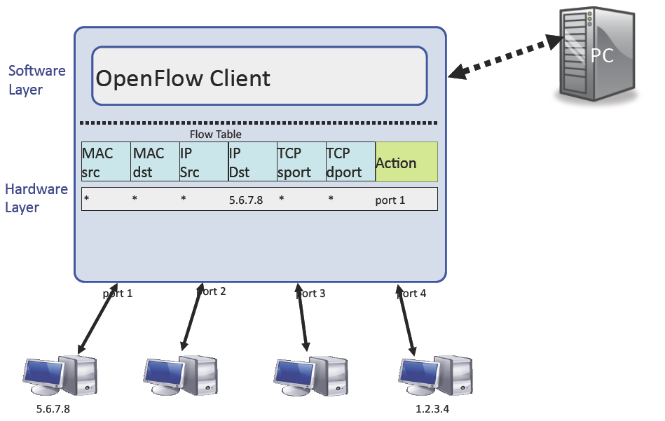
OpenFlow Flow Table Abstraction
Controller

Slide 29
Flow entry examples
Switching
Switch
Port
MAC
src
MAC
dst
Eth
type
VLAN
ID
IP
Src
IP
Dst
IP
Prot
TCP
sport
TCP
dport
Action
*
*
00:1f:..
*
*
*
*
*
*
*
port6
Flow Switching
Switch
Port
MAC
src
MAC
dst
Eth
type
VLAN
ID
IP
Src
IP
Dst
IP
Prot
TCP
sport
TCP
dport
Action
port3
00:20..
00:1f..
0800
vlan1
1.2.3.4
5.6.7.8
4
17264
80
port6
Firewall
Switch
Port
MAC
src
MAC
dst
Eth
type
VLAN
ID
IP
Src
IP
Dst
IP
Prot
TCP
sport
TCP
dport
Forward
*
*
*
*
*
*
*
*
*
22
drop
Routing
Switch
Port
MAC
src
MAC
dst
Eth
type
VLAN
ID
IP
Src
IP
Dst
IP
Prot
TCP
sport
TCP
dport
Action
*
*
*
*
*
*
5.6.7.8
*
*
*
port6
VLAN Switching (Efficient !!!)
Switch
Port
MAC
src
MAC
dst
Eth
type
VLAN
ID
IP
Src
IP
Dst
IP
Prot
TCP
sport
TCP
dport
Action
port6,
port7,
port9
*
*
00:1f..
*
vlan1
*
*
*
*
*

Slide 30
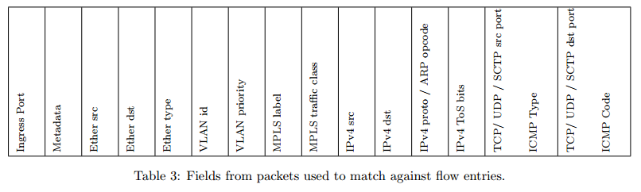
OpenFlow Header v.1.1

Slide 31
OpenFlow Switch
OpenFlow-compliant switches come in two types:
OpenFlow-only: support only OpenFlow operation, in those switches all packets are processed by the OpenFlow pipeline, and can not be processed otherwise.
OpenFlow-hybrid: support both OpenFlow operation and normal Ethernet switching operation, i.e. traditional L2 Ethernet switching, VLAN isolation, L3 routing (IPv4 routing, IPv6 routing...), ACL and QoS processing.
The OpenFlow pipeline of every OpenFlow switch contains multiple flow tables, each flow table containing multiple flow entries.

Slide 32
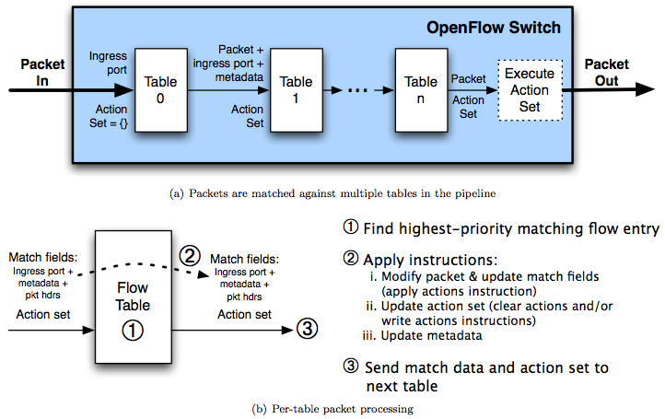
OpenFlow matching process
ONF, “OpenFlow Swith Specification v.1.3.0”, June, 2012

Slide 33
Programmability
OpenFlow native programmability
Redefined the flow format, actions, and etc.
Controller programmability
Call Openflow provided API to control

Slide 34
OpenFlow Controllers
Name | Language | Platform(s) | Original Author | Notes
Openflow Reference | C | Linux | Stanford/Nicira | Not designed for extensibility
Nox/Pox | Python, C++ | Linux | Nicira | Actively developed
Beacon | Java | Win, Mac, Linux, Android | David Erickson (standford) | Runtime modular, web UI framework, regression test framework
Trema | Ruby, C | Linux | NEC | Includes emulator, regression test framework
Ryu | Python | Linux | NTT | Supports openstack and openflow 1.3
Floodlight | Java | any | BigSwitch | Support openstack and java based

Slide 35
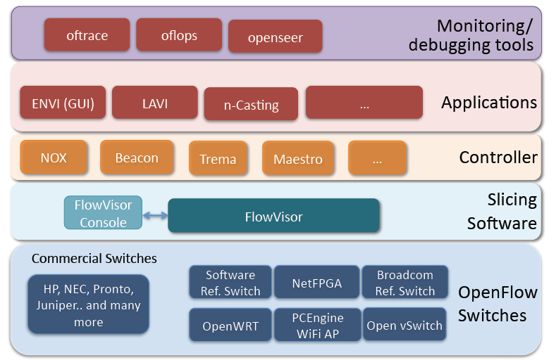
SDN Stack
Notes:
This is all GENI or other project upon openflow architecture

Slide 36
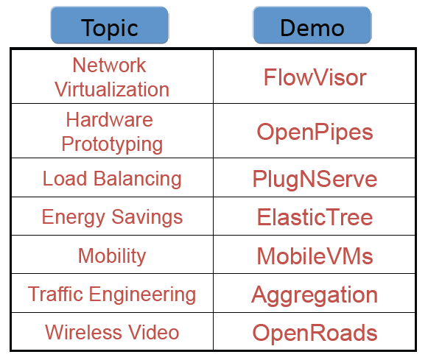
Example of OpenFlow Applications

Slide 37
References
Scott Shenker, Software Defined Networking, http://inst.eecs.berkeley.edu/~ee122/
OpenFlow official website at http://www.openflow.org
NOX controller at http://www.noxrepo.org/
J. Pettit, J. Gross, B. Pfaff, M. Casado, S. Crosby, “Virtual Switching in an Era of Advanced Edges,” 2nd Workshop on Data Center – Converged and Virtual Ethernet Switching (DC-CAVES), ITC 22, Sep. 6, 2010.
B. Pfaff, J. Pettit, T. Koponen, K. Amidon, M. Casado, S. Shenker, “Extending Networking into the Virtualization Layer,” HotNets-VIII, Oct. 22-23, 2009.
S. Zhou, “Virtual Networking,” ACM SIGOPS Operating Systems Review, 2010.
N. Mckeown et al., “OpenFlow: Enabling Innovation in Campus Networks,” white papers. The OpenFlow Switch Consortium, March 2008, http://www.openflowswitch.org//documents/openflow-wp-latest.pdf
Y. Luo et al., “Accelerating OpenFlow Switching with Network Processors,” Proc. ACM/IEEE Symp. Architectures for Networking and Communications Systems (ANCS 09), ACM Press, 2009.
J. Naous et al., “Implementing an OpenFlow Switch on the NetFPGA platform,” Proc. ACM/IEEE Symp. Architectures for Networking and Communications Systems (ANCS 08), ACM Press, 2008.
H. Chen et al., “A Survey on the Application of FPGAs for Network Infrastructure Security,” IEEE Communications Surveys & Tutorials, June 2010.
F. Azmandian et al., “Virtual Machine Monitor-Based Lightweight Intrusion Detection,” ACM SIGOPS Operating Systems Review, July 2011.
H. Bos and K. Huang, “A network intrusion detection system on ixp1200 network processors with support for large rule sets,” in Technical Report 2004-02. Leiden University, 2004.

